Slide 1
BEFORE AND AFTER
Notes:
Photo manipulation, once the preserve of a small number of airbrush-equipped artists, has become commonplace in the fashion, publishing and advertising industries thanks to the introduction of photo-editing software such as Photoshop.

Slide 2
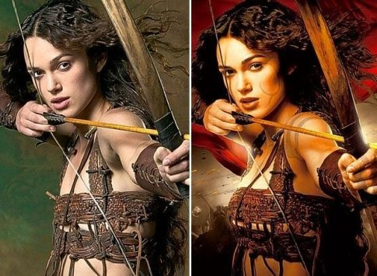
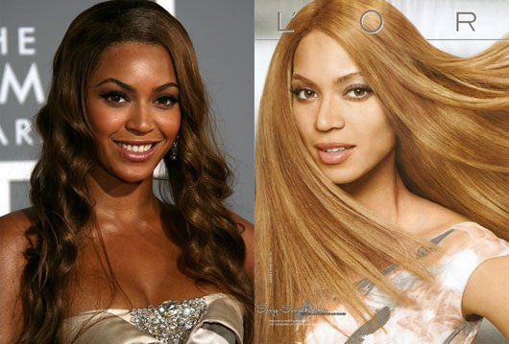
Notes:
Photos may be retouched for any number of reasons – to make models thinner, or bustier, or to change skin tone.
Retouching photos in this way raises a number of concerns. One is that the already unrealistic bodies youth are exposed to are made literally impossible – models frequently have collarbones, ribs and even hips erased to make them look thinner – guaranteeing that even those who meet media standards of attractiveness will still be left feeling inadequate.

Slide 3
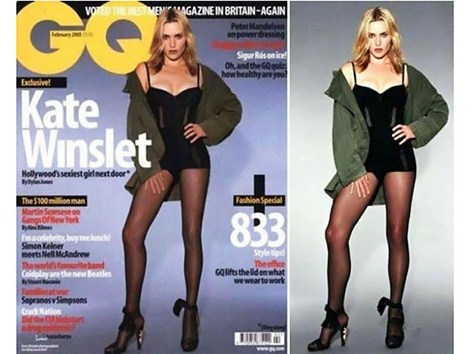
“The retouching is excessive. I do not look like that and more importantly I don't desire to look like that.
I actually have a Polaroid that the photographer gave me on the day of the shoot… I can tell you they've reduced the size of my legs by about a third. For my money it looks pretty good the way it was taken.”
Notes:
The models themselves may not know how their photos are going to be manipulated, and sometimes object when they see the final result.

Slide 4
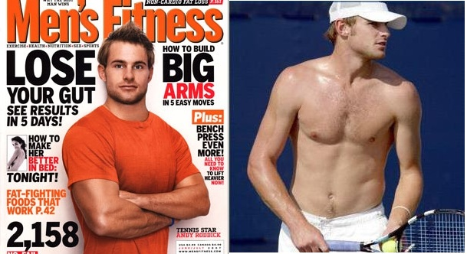
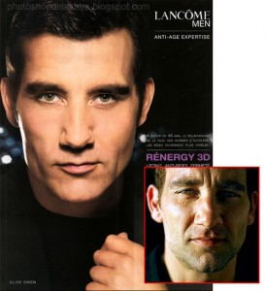
Notes:
Men’s photos are frequently retouched as well, but research has found that boys’ self-image is affected by seeing unrealistic images of men or women.

Slide 5
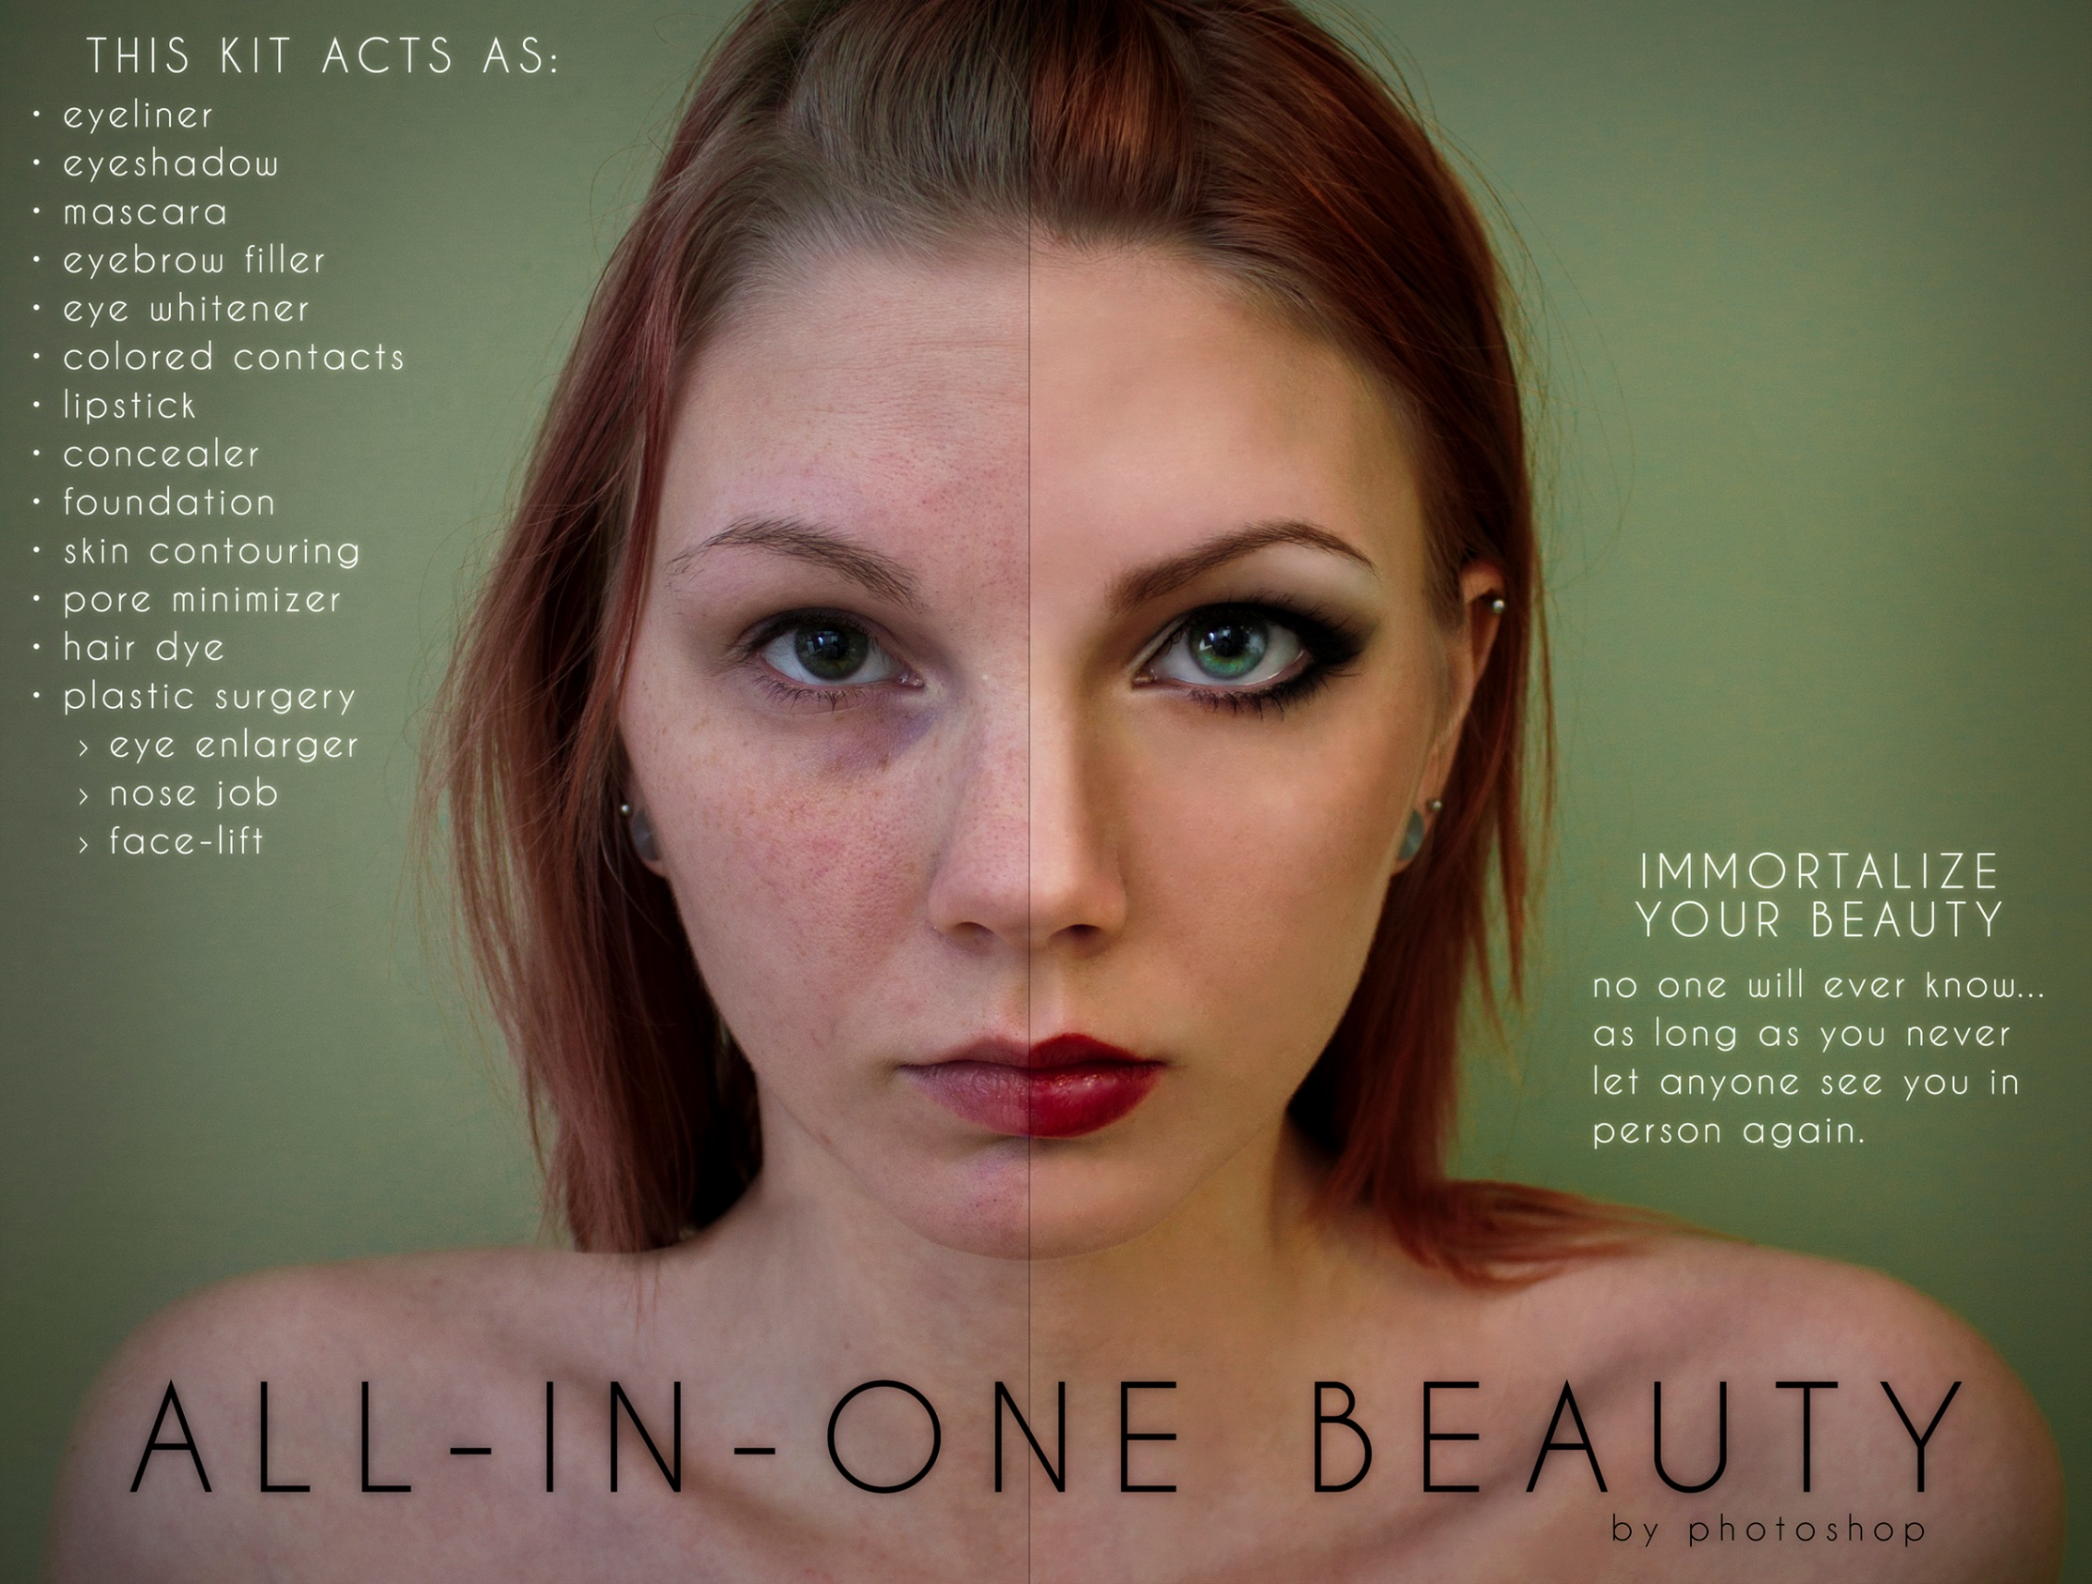
“When I suddenly went back to the unedited layer, it looked so wrong and kinda gross. It made me extra aware of how skewed my perception was after looking at the edited ones for a while.”
Notes:
University student Anna Hill created this mock ad as part of a photography class. She later said that the process made her feel more critical of how she looked in her original photos, even though she had taken and manipulated them herself.

Slide 6
“Wanna know my secret? …
I swapped my bather bottoms to black (cause they're a size bigger & black is slimming), Smothered on some fake tan, clipped in my hair extensions, stood up a bit taller, sucked in my guts, popped my hip- threw in a skinny arm, stood a bit wider, pulled my shoulders back and added a bit of a cheeky/I’ m so proud of my results smile. Zoomed in on the before pic- zoomed out on the after & added a filter…
What's my point? Don't be deceived by what you see in magazines & on Instagram. You never see the dozens of other pics they took that weren't as flattering.”
Notes:
As we’ve seen, lots of kids are experts at copying the “Photoshop look” just using things like poses, light and camera angle and position.

Slide 7
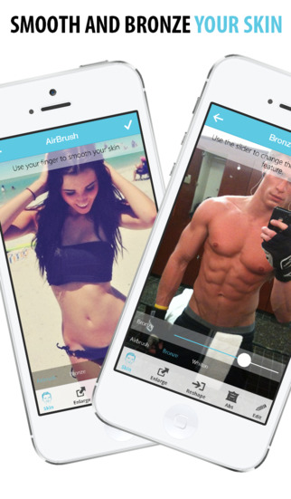
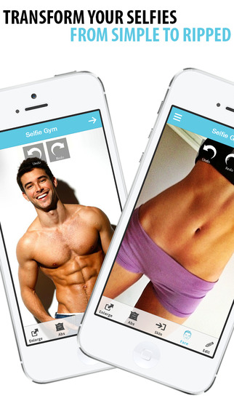
“Girls understand that the images on television and in magazines are manipulated, and for some this understanding seems to lead to an expectation that they can (or should) be doing the same.”
Connie Morrison, Who Do They Think They Are?
Notes:
But apps like this one offer kids the chance to step beyond that and actually manipulate their pictures digitally. Unfortunately, this sometimes means that as well as comparing ourselves to artificially perfect images of celebrities, we compare ourselves to artificially perfect images of our friends – even when we know what they really look like.

